Slide 1


Impact of Social Sciences, Humanities and Arts Conference
The Parallel Session on:
Science Policy and Funding Schemes
13 October, 2021

Slide 2


Impact of Social Sciences, Humanities and Arts
13-15 October, 2021
Jenny Björkman (Chair): Director of Collaboration, Riksbanken Jubileumsfond, Sweden
Frederik Van Acker: Senior Policy Advisor at the Research Foundation Flanders (FWO), Belgium
Frans Nauta: Founder ClimateLaunchpad & Innovation Policy Expert, the Netherlands
Overview of the Speakers
#SSHA21

Slide 3
Impact of Social Sciences, Humanities and Arts
13-15 October, 2021
Jenny Björkman
Director of Collaboration, Riksbanken Jubileumsfond, Sweden
#SSHA21

Slide 5
Riksbankens Jubileumsfond (RJ)
is an independent foundation with the goal of promoting and supporting
research in the Humanities and Social Sciences with
links to Sweden.
text

Slide 6
One of Sweden’s leading funding organizations of humanities and social sciences research
AWARDED GRANTS 2010–2019

Slide 7
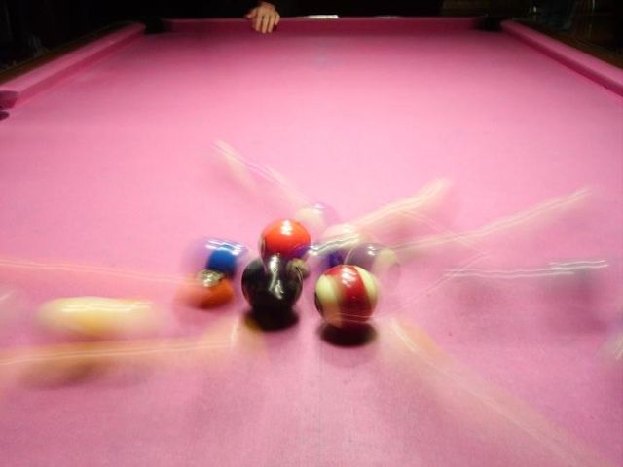



Impact, science communication and evaluations
Evaluating impat in order to work more effective
640px-Biljard.JPG (640×480) (wikimedia.org)

Slide 8
TWIST – a short film project
Independent of the research that is being told.
Artistic language combined with facts
Heart and brain, where something unexpected can happen

Slide 9
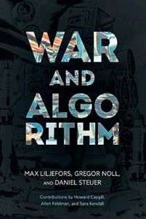
A research-project that became a film
Gregor Noll et al:
Digitalized Warfare: Responsibility, Intentionality and the Rule of Law
The research highlights the ethical challenges presented by the accelerated advance of Artificial Intelligence (AI) in the absence of public policy and industry standards to ensure development in the public interest.

Slide 10

Impact evaluation was employed to assess whether seeing the film caused changes in knowledge, awareness, attitudes, and actions .
text

Slide 11
Measures of confidence
The robustness of the sample
Representative, higher than average retention rate between Waves 1 and 2.
The quality of the film
3 minutes is long for a mobile-phone survey but respondents’ interest was maintained for the duration.
Spontaneous responses to the film’s main messages
Accuracy wave 1- 98% of responses
Accuracy wave 2- 46% of responses
Retention of film’s messages
High level of retention after an interval of 4 weeks.
Subsequent action
Wave 1- 20% of respondents said they would seek more information about AI as the result of seeing the film.
Wave 2- 30% of respondents actually had sought more information.
Awareness
Significant changes in levels of awareness about personal responsibility in a legal context and the challenges that AI poses in both Wave 1 and Wave 2. - 65 % more aware!

Slide 12

Learnings
Impact is possible.
Impact evaluation is an effective method to measure the effect.
Templates and models can help researchers.
The broader public exists and can be reached.

Slide 13

  TACK!
  Stiftelsen Riksbankens Jubileumsfond
  Jenny Björkman
  Jenny.bjorkman@rj.se
  Visiting address:
  Regeringsgatan 67, Stockholm
  www.rj.se
  www.facebook.com/RiksbankensJubileumsfond

Slide 14
Impact of Social Sciences, Humanities and Arts
13-15 October, 2021
Frederik Van Acker
Senior Policy Advisor at the Research Foundation Flanders (FWO), Belgium
#SSHA21

Slide 15
The FWO-SBO programme:
Funding for impact

Slide 16
Overview
  The SBO programme
  How to fund for impact?
  SBO in practice
    Example of the road to impact
    Lessons learned: what makes research impactful?
    Challenges for SSH

Slide 17
1. The SBO programme

Slide 18
1. The SBO programme

Slide 19
























1. The SBO programme
Utilisation
Research consortium
Product
Service
Result
industry
Spin-off
Society
Advisory committee
Societal value

Slide 20


1. The SBO programme
SBO
Venture capital?

Slide 21

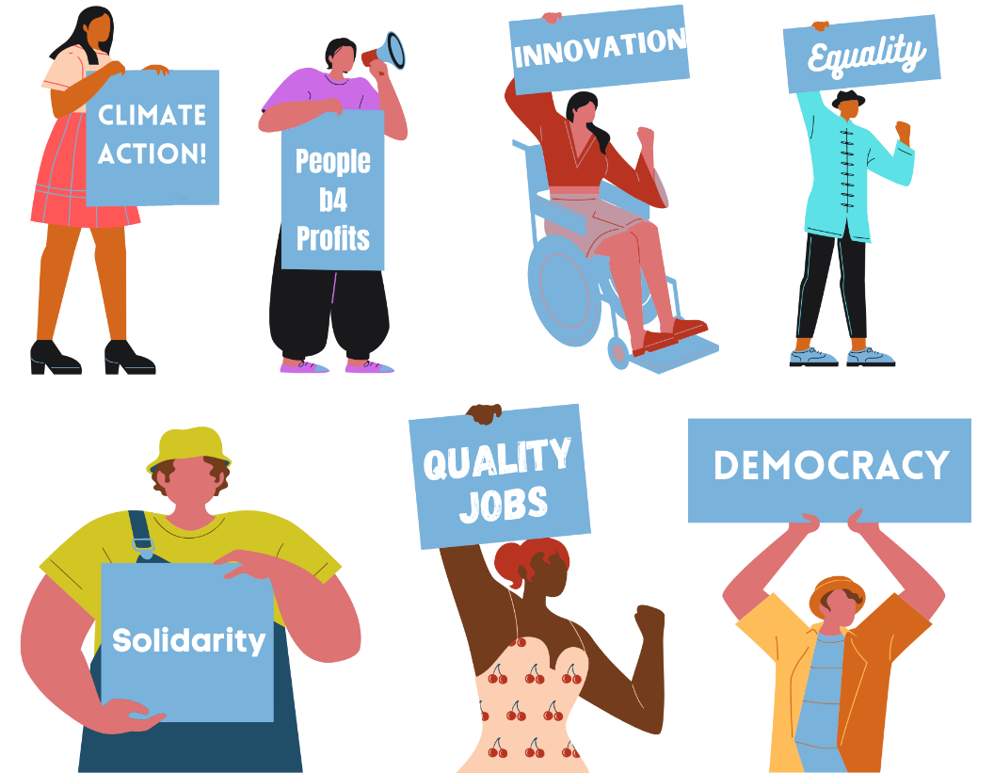
1. The SBO programme
SBO-E
SBO-M

Slide 22
2. How to fund for impact?

Slide 23
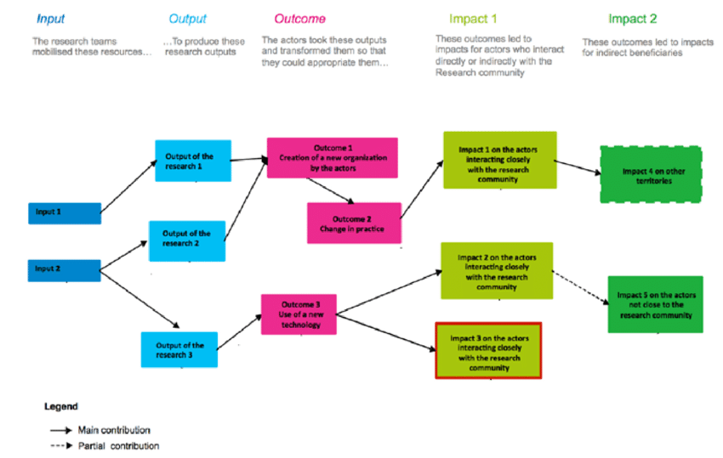
2. How to fund for impact?

Slide 24

2. How to fund for impact?

Slide 25

Weak end-user involvement

Slide 26

Weak engagement of decision-makers and stakeholders, including civil society and community

Slide 27


Lack of planning and resources for adoption

Slide 28

Lack of incentives to cross or pull across

Slide 29

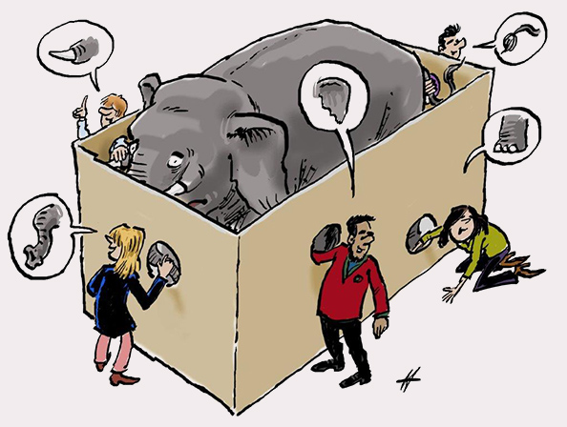
How to evaluate for impact?

Slide 30
3. SBO in practice

Slide 31
3a. Example of the road to impact

Slide 32



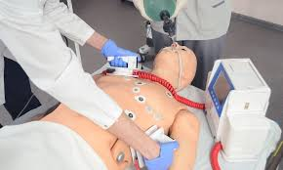
Example of the road to impact
End-of-Life care (prof. Deliens)

Slide 33


Example of the road to impact

Slide 34
3b. What makes projects impactful?

Slide 35

What makes projects impactful?

Slide 36

What makes projects impactful?

Slide 37
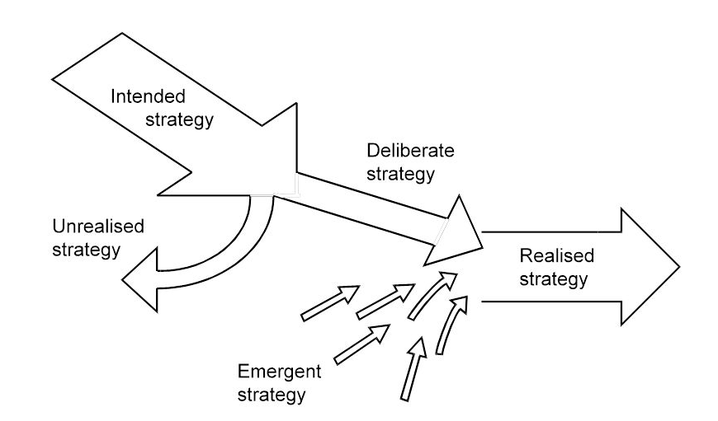

What makes projects impactful?

Slide 38
3c. Challenges for SSH

Slide 39
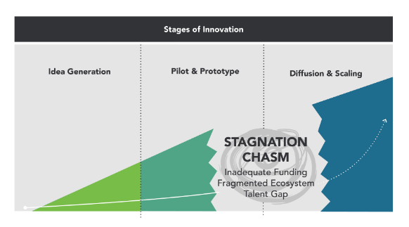
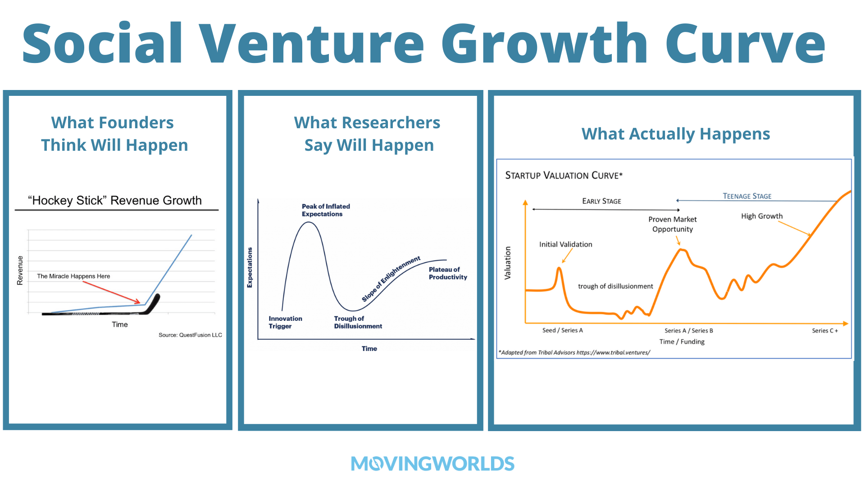
Challenges for SSH

Slide 40
Additional information
SBO webpage: https://www.fwo.be/en/fellowships-funding/research-projects/sbo-projects/

Slide 42
Impact of Social Sciences, Humanities and Arts
13-15 October, 2021
Frans Nauta
Founder ClimateLaunchpad & Innovation Policy Expert, the Netherlands
#SSHA21

Slide 43



Faculty of Impact:
A national Academic Impact Program
13 October 2021
Frans Nauta, founder Faculty of Impact

Slide 44

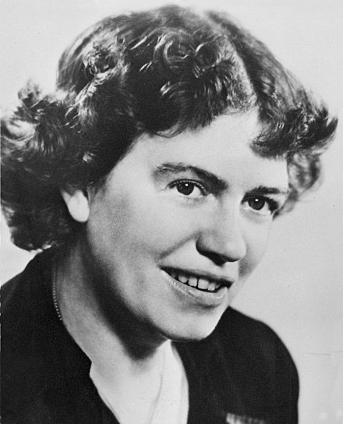
Hopeful...
'Never doubt that a small group of thoughtful, committed citizens can change the world; indeed, it's the only thing that ever has'
Margaret Mead

Slide 45

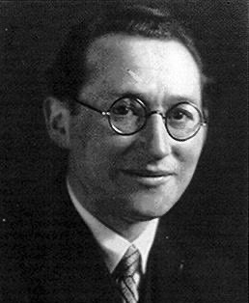
Some humbleness
'If you want truly to understand something, try to change it'
Kurt Lewin

Slide 46

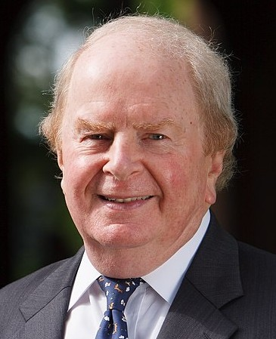
def. Entrepreneurship
'The pursuit of opportunity without regard to the resources currently controlled'
Stevenson, 1989

Slide 47

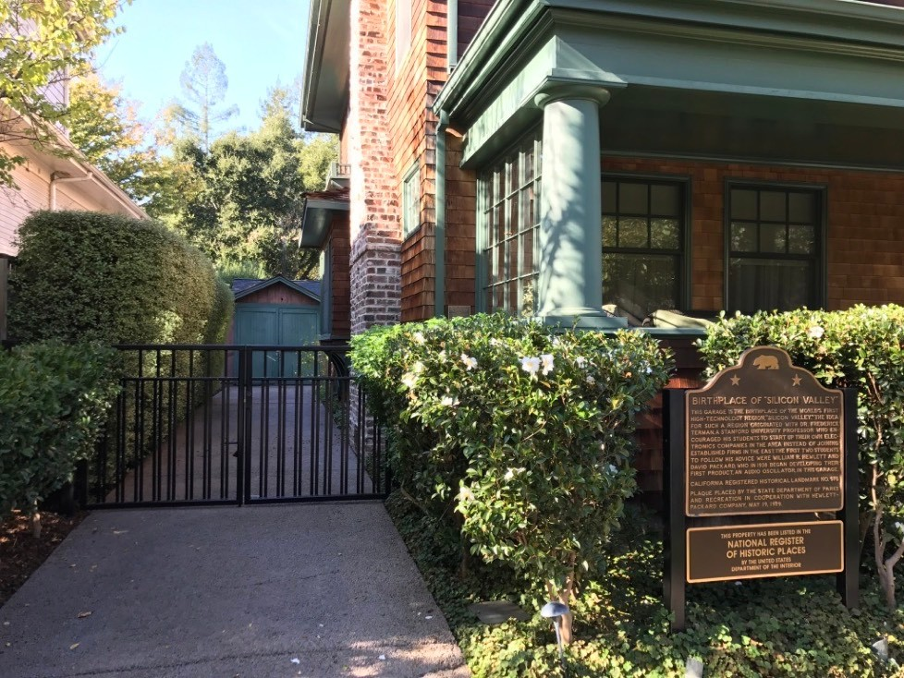
History
Role model Silicon Valley: TTO & startups
First adoption EU: Leuven R&D, IMEC
First adoption NL: University Twente, Leiden Bio Science Park
Publicly visible 2003 through YES!Delft

Slide 48
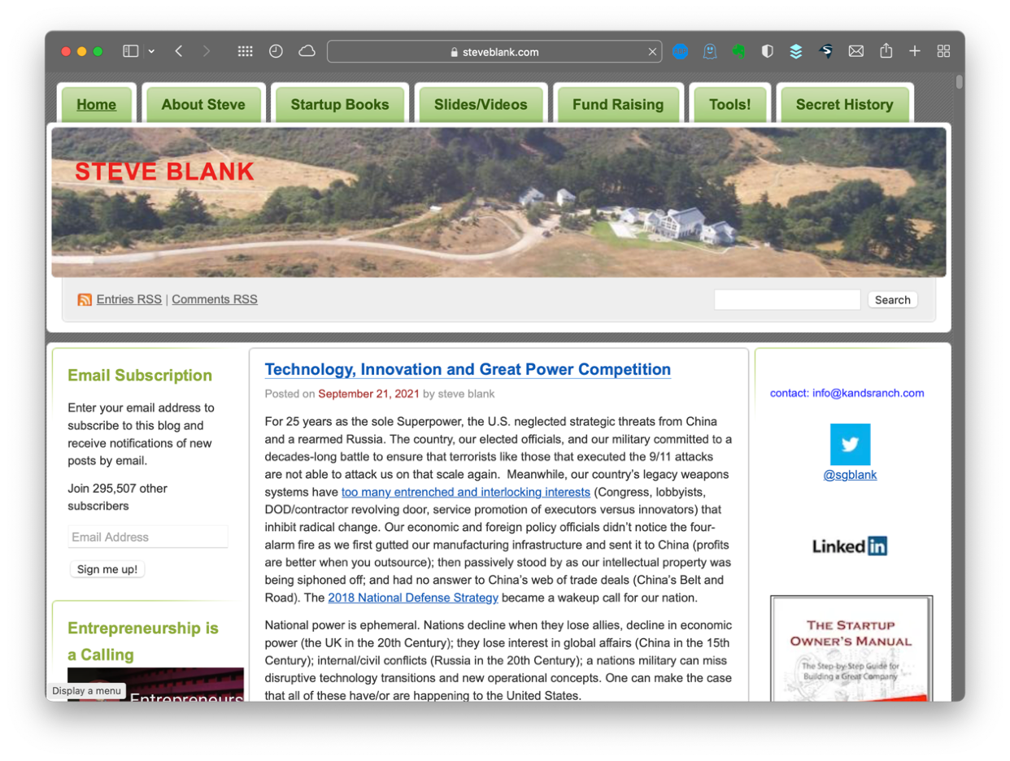
History (2)
2000 - 2010: Entrepreneurship from DNA to teachable skill
2007: YC & rise of Accelerators
2011: NSF I-Corps, Climate-KIC Accelerator
2014: Cyclotron Road @ Berkeley
2021: Faculty of Impact NL

Slide 49


Key Insights
Translational research ≠ Patents & TTO
Being laser focussed = key to success
It requires a lot of time of people
(So it's expensive)
Not a profitable business case for universities, but it is for society as a whole
Requires culture & incentives that reward faculty focus on impact

Slide 50



Inspired by:
Teams | ≈1.000 | 32 | 56
Program costs | ≈100 M€ | 7,5 M€ | 18 M€
per team | 100 k€ | 234 k€ | 320 k€
Follow on funding | ≈ 2.000 M€ | 124 M€ | 150 M€
per team | ≈ 2 M€ | 3,9 M€ | 2,6 M€
Focus | Climate, early stage | AI software, pre seed | Energy, pre seed
Multiplier/team | 20 | 16 | 8
Start date | 2012 | 2014 | 2014

Slide 51
Faculty of Impact
Mission: Translate most advanced, promising insights from science to public value
Inspired by Cyclotron Road Berkeley, Runway program Cornell Tech
Developed by Dutch universities, NWO-TTW en Techleap
Ambition = world class

Slide 52
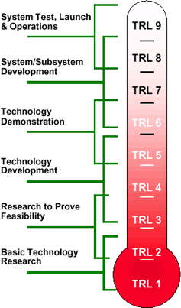
Program Outline
Postdocs 2 years from TRL 4-5 to TRL 6-7
Two years salary, work space, lab access & embedded research group Midterm T-crossing: return to science or entrepreneurial path
-
-
One week per month entrepreneurship program:
Training & coaching Funding scouting & support
Networks with sponsors (government, business, investors)
-
-
-
Focus for each group: 2021 cohort Sustainability
International program with Cyclotron Road & Runway

Slide 53


Timing
Nov 2021: NWO call open
Feb - Apr 2022: Selection process
Apr: Announcement max. 10 fellows
May: Start program

Slide 54


Challenges
European version & language of scaling solutions
Diversity of people and knowledge in programs
Balance between national program and local embeddedness
Long term funding
'Culture eats strategy for breakfast'
Reward systems faculty, tenure, leadership

Slide 55

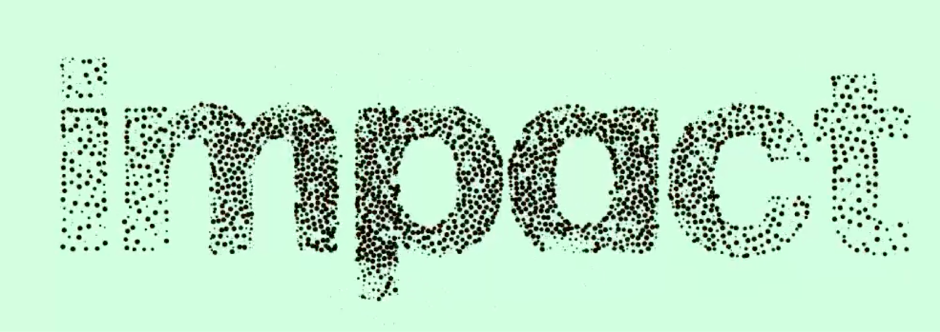
'Asks'
Eager to learn about similar initiatives
Happy to build public library with tools for academic impact programs
Interested? Please reach out: frans@facultyofimpact.nl
Follow us: www.facultyofimpact.nl

Slide 56
Impact of Social Sciences, Humanities and Arts
13-15 October, 2021
Thank you!
#SSHA21

